Slide 1

Charter school
updates
Quarter 2
November 13, 2025
1

Slide 2
Special Projects Updates
R.A.N. Reminders
Reimbursement Reminders
Taggable Items Reminders
Agenda
Grant Specific
IDEA Individuals with Disabilities Education Act
Stronger Connections
UNISIG
Title I
Comprehensive Support Grant (CSG) New
Title II & Title IV
School Hardening
2

Slide 3
Special Projects Updates
R.A.N. Reminders
Reimbursement Reminders
Taggable Items Reminders
Agenda
Grant Specific
IDEA Individuals with Disabilities Education Act
Stronger Connections
UNISIG
Title I
Comprehensive Support Grant (CSG) New
Title II & Title IV
School Hardening
3

Slide 4

Special Projects
updates
4

Slide 5

Reasonable
Allocable
Necessary
Would an average person think this is a sensible way to spend grant funds?
Can the connection between this cost and the project's objectives be clearly demonstrated?
Is this expense required to accomplish our grant objectives?
Reasonable costs are expenses that a prudent person would consider sensible and appropriate under the circumstances.
For a cost to be allocable, it must have a clear connection to the grant and contribute to its objectives.
Necessary costs are expenses that are essential for achieving the goals of the grant project.
5

Slide 6



Reimbursement Process
Cover Letter
Proof of Payment
Invoice
6

Slide 7
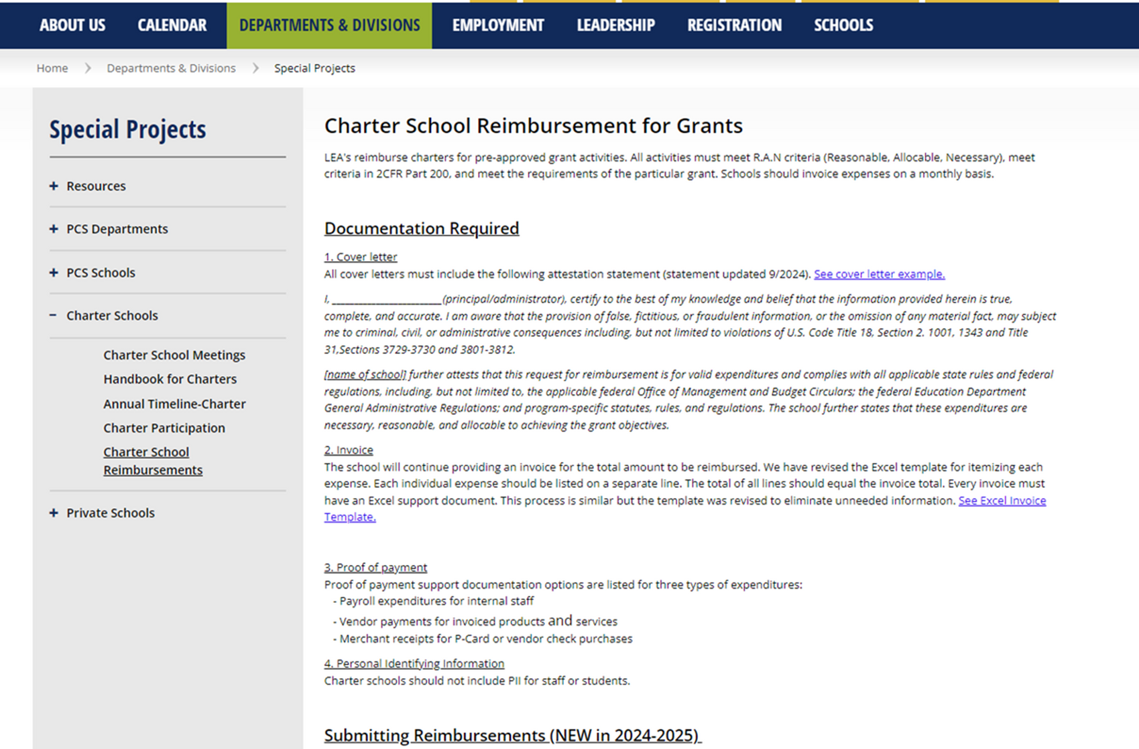
Reimbursement Process
7
Notes:
Title I will also be moving to this process.

Slide 8
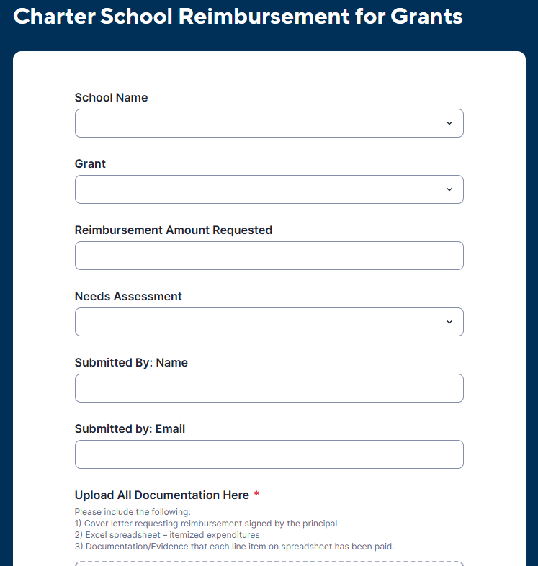
Reimbursement Process
8

Slide 9
Reimbursement Process
Title 1
added for 25-26
9

Slide 10

Reimbursement Hangups
Bank Back Up- partial months
Addition - Total amount on itemized spreadsheet
Tax - Not removed on purchases, receipts, etc.
Frequency - Combining many months
Overabundance - Too much unnecessary back-up documentation

Slide 11

Taggable Items
Please make sure that when you receive tags for taggable items that you complete the form that comes with them which provides us with the serial number. When this is returned to purchasing, they complete the asset in TERMS officially making it part of inventory and attached to the grant.
We need these forms ASAP and will now be making a follow up request as part of the process every time.
It’s NOT just a “checkmark” item - It’s really important!
11

Slide 12
Special Projects Updates
R.A.N. Reminders
Reimbursement Reminders
Taggable Items Reminders
Agenda
Grant Specific
IDEA Individuals with Disabilities Education Act
Stronger Connections
UNISIG
Title I
Comprehensive Support Grant (CSG) New
Title II & Title IV
School Hardening
12

Slide 13

Individuals with Disabilities act
Supply Funds:
Reimbursement requests due by end of school year
Funds must support students with disabilities (SWD)
Reimbursements due by June 1, 2026!
13

Slide 14








Individuals with Disabilities act
Excess Cost
IDEA Supplies must be directly tied to a student’s IEP and represent an excess cost—additional expenses a school incurs to provide special education and related services, above what is spent on an average student.
14

Slide 15
Stronger Connections
Stronger Connections
Allowable Activities
School Climate and Behavior Mental Health Institute
MTSS, Social Work and Behavioral Services
Supplemental Intensive Behavior Services Through Board Certified Behavior Analysts
Background:
Stronger Connections is entering the final months of the 3-year grant cycle.
Important Charter Update:
If your charter does not plan to use its remaining Stronger Connections allocation...
You will soon receive a short opt-out/return-of-funds letter.
OPTION A
Complete your Needs Assessment
Once approved, spend the funds by June 30th.
OPTION B
Sign and return the provided letter
Funds will be re-allocated
15

Slide 16

Unified School Improvement Grant
The Unified School Improvement Grant (UniSIG) provides federal funding to schools identified for improvement.
A school can be identified to receive UniSIG in any of the following three ways:
Have an overall Federal Index below 41%
Have a graduation rate at or below 67%
Have a school grade of a D or F
Charter schools that qualify can use these funds for strategies and resources that support student learning and align with their School Improvement Plan. Reimbursements may be submitted for expenditures during the program period of August 1, 2025 to July 31, 2026.
UniSIG for the 25-26 school year has not yet been awarded; once funds are available, Special Projects will reach out to the designated schools.
16

Slide 17

COMPREHENSIVE SUPPORT GRANT (CSG)
The Comprehensive Support Grant (CSG) is new this year and is a one-time allocation to provides federal funding to schools to support underperforming subgroups.
A school is eligible for CSG if any of their subgroups have performed below 41% on the Federal Percent of Points Index for the past six consecutive years.
Reimbursements may be submitted for expenditures during the program period of October 24, 2025 to July 31, 2026.
CSG for the 25-26 school year has not yet been awarded; once funds are available, Special Projects will reach out to the designated schools.
17

Slide 18
Title I, Part A
Title 1
Reimbursement Reminder
18

Slide 19
Title II & Title IV
Updates
19

Slide 20
Title II and Title iv
Federal Freeze Updates
24-25 No Cost Extension (which means no roll forward in the spring)
25-26 Base Allocation only
20

Slide 21
Title II and Title iv
Grant Period July 1, 2025 to June 30, 2026
Reimbursements due by July 1, 2026
21

Slide 22
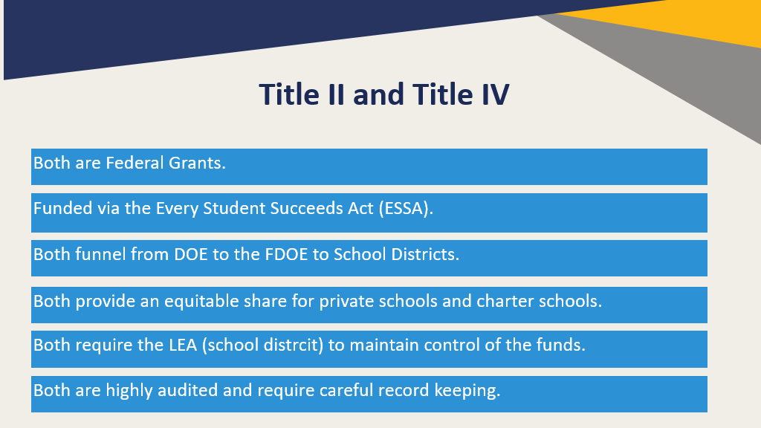
Title II and Title iv
22

Slide 23
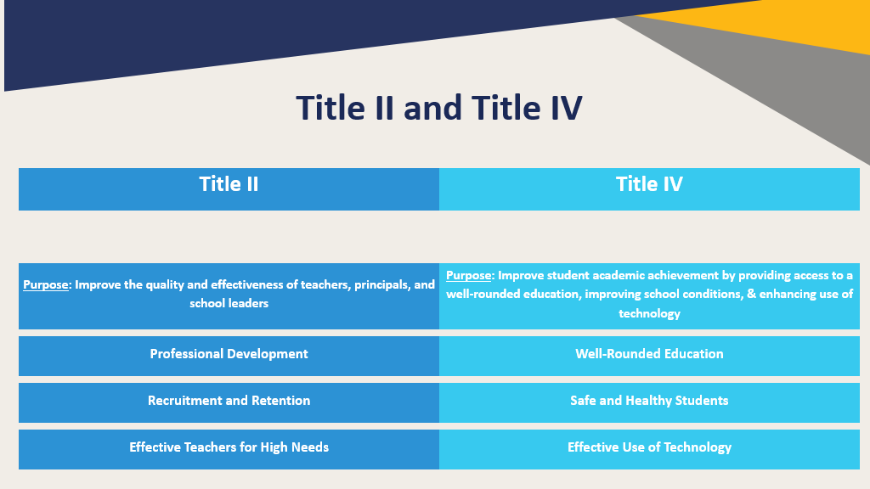
Title ii and title iv
23

Slide 24
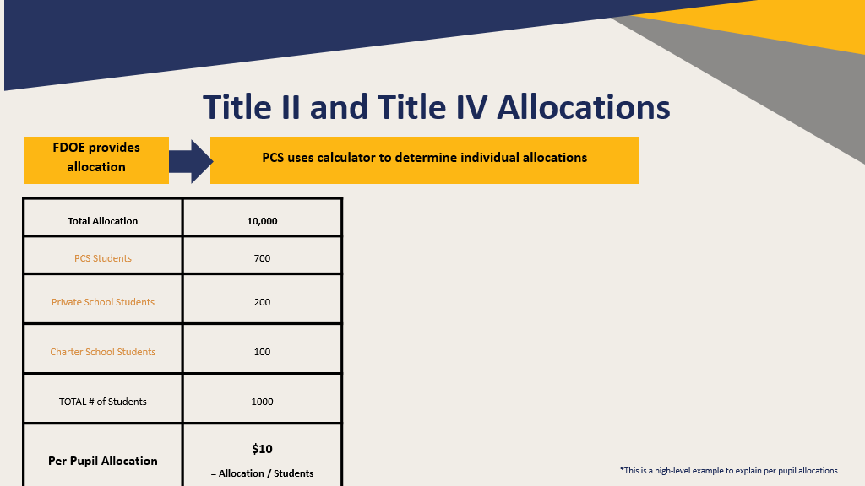
title ii and title iv allocations
24

Slide 25
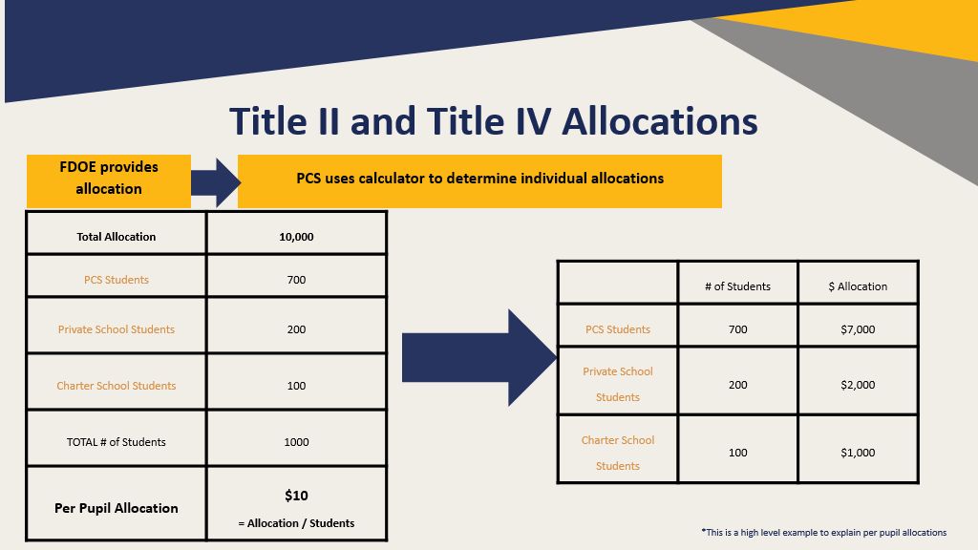
title ii and title iv allocations
25

Slide 26
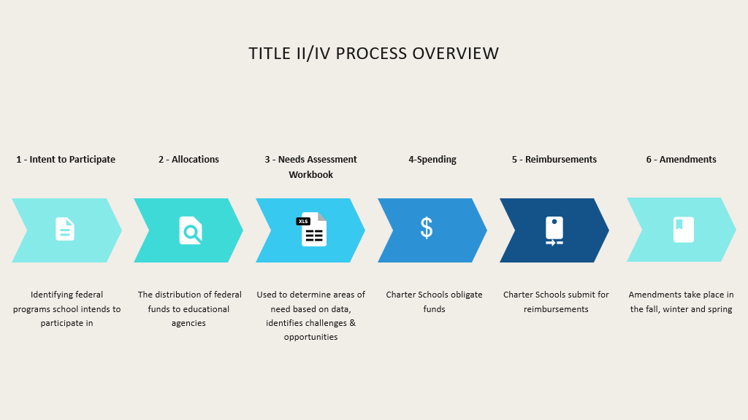
title ii & title iv process overview
26

Slide 27
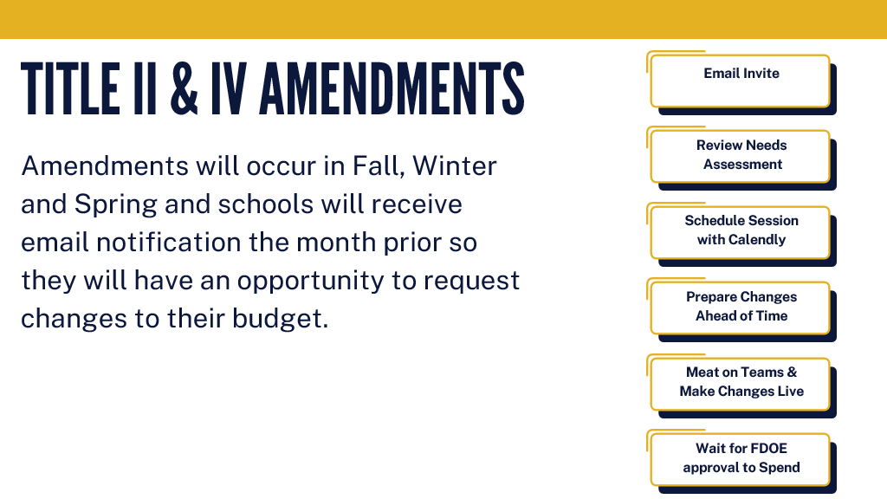
Amendments
27

Slide 28
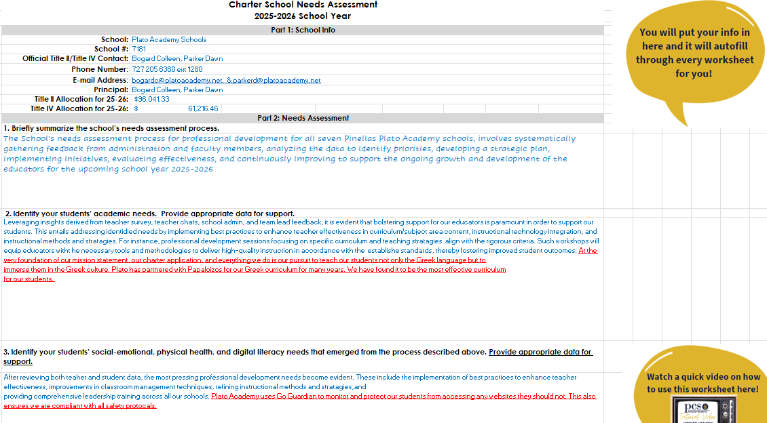


Needs Assessments
28

Slide 29
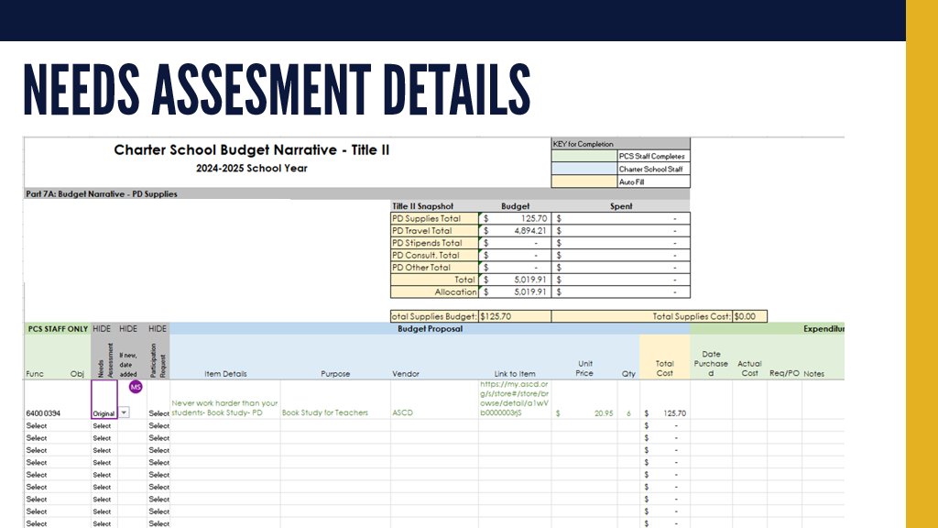
Needs Assessments
29

Slide 30
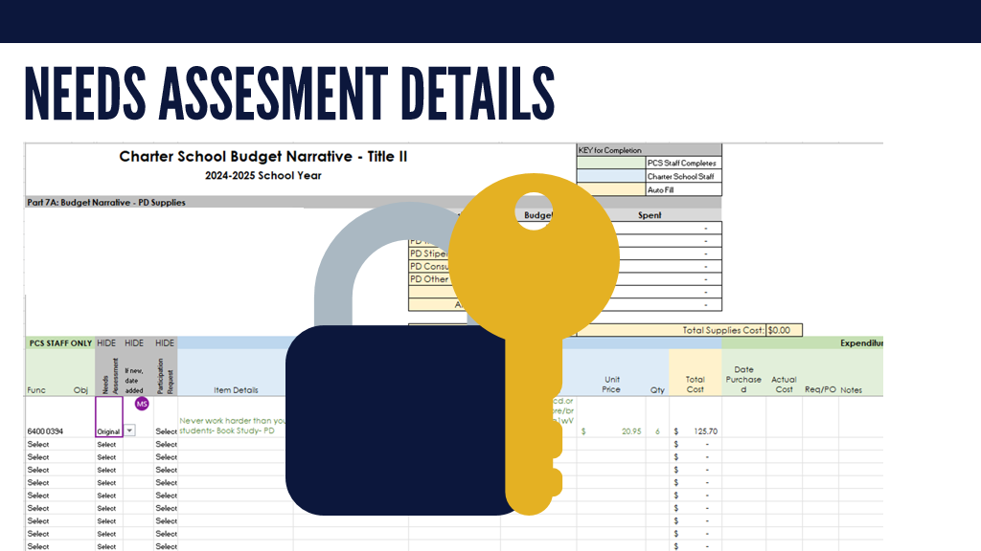
Needs Assessments
30

Slide 31
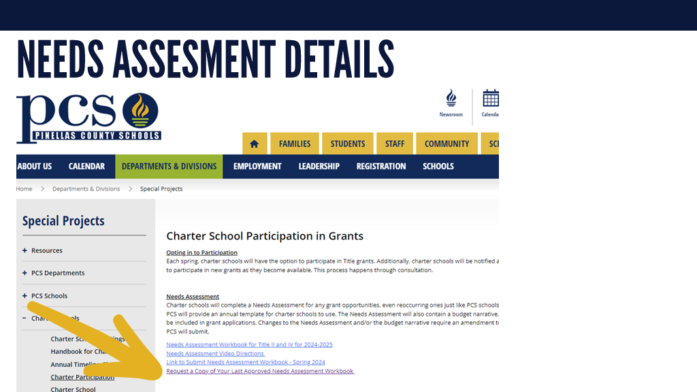
Needs Assessments
31

Slide 32
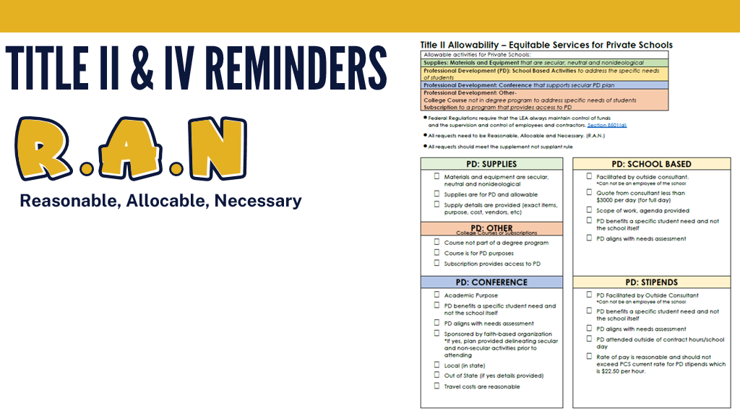

R.A.N.
32

Slide 33
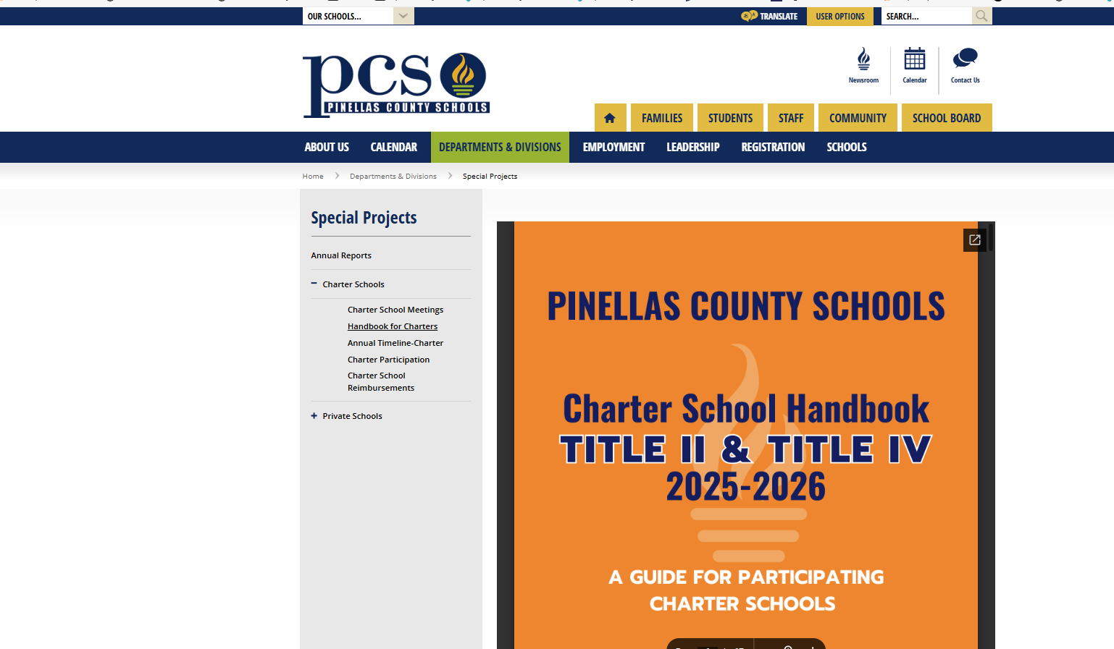

Charter school handbook
33

Slide 34

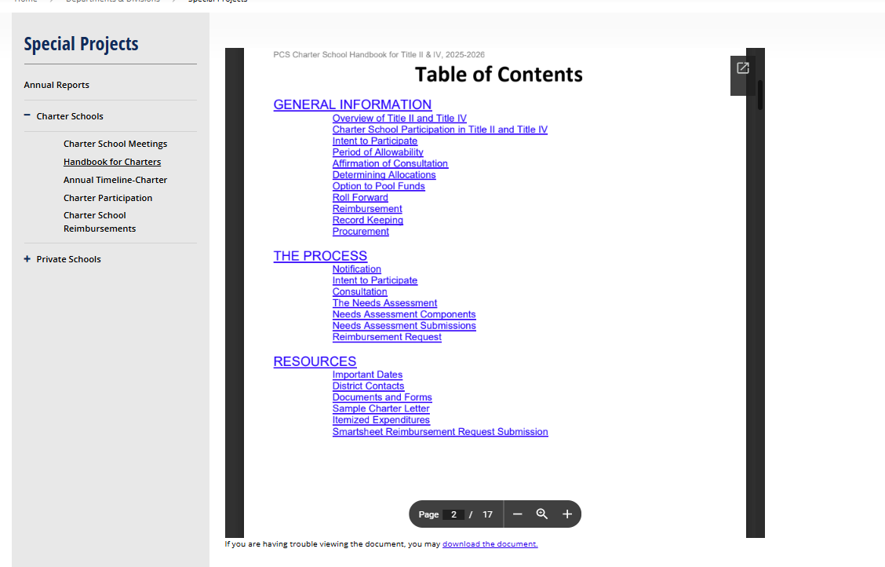
Charter school handbook
USE ONLINE VERSION FOR CURRENT, MOST UP-TO-DATE INFORMATION!
34

Slide 35

School Hardening Grant
Grant 3289:
Must reimburse before the Thanksgiving Holidays (due by November 22)
Program Period from July 1st 2023 to January 31st 2026
Grant 3288:
Awarded recently
May begin reimbursements January 2026
Program Period from July 1st 2024 to January 31st 2027
Grant 3287:
RFA to be released soon
Intent to apply will be sent out in December
Program Period from July 1st 2025 to January 31st 2028
35
Notes:
Please let the charters know they must reimburse 3289 before the Thanksgiving holidays. Once 3289 closes in January 2026, schools will be able to reimburse 3288 which was awarded last week

Slide 36
36

